Slide 1

Interpretation of Taxing statutes
Dr. KN Chaturvedi

Slide 2
Constitutional provisions
India is a union of States. The main function of Parliament and the state legislature is to make laws. The taxing power is given to the Parliament and state legislature. For example, entry 82 list I empowers Parliament to tax on income other than agricultural income. Similarly, entry 46 of List II of the seventh schedule empowers the state legislature to tax on agricultural income. A proposal for new legislation or to amend an existing legislation or repeal a pre-independence legislation is initiated in the concerned Ministry or department of the Government of India

Slide 3
Formulation of tax policies
In taxation matters, the Ministry of Finance is the concerned Ministry. The apex body in direct taxes is the Central Board of Direct Taxes and in indirect taxes is the Central Board of Indirect Taxes and Customs.
In the formulation of tax policies, experimentation is inevitable. Since independence, many taxation laws have been enacted by the parliament. In many cases, a new tax law is based on the report of a Commission or committee. For example, the Income Tax Act of 1961 is primarily based on the 12th report of the Law Commission of India. Similarly, in the Finance Act 1994 for the first time service tax was introduced on a limited number of services based on the Raja Chelliah Committee report. A new structure of indirect taxes in the form of the Goods and Services Tax Act came into effect in 2017.

Slide 4
Legislative process: Drafting of tax proposals
A tax proposal for direct taxes is prepared under the supervision of a joint secretary in the Tax Planning and Legislation division, Central Board of Direct Taxes. A proposal for indirect taxes is prepared in the Tax Research Unit division in the Central Board of Indirect Taxes and Customs. Now, there is a common policy unit. Tax Policy Research Unit and Tax Policy Council.
Every tax proposal is required to be approved by the Minister of Finance, Government of India.
Based on all the tax proposals of direct and indirect taxes, a draft bill is prepared in the legislative department of the Ministry of Law and Justice in consultation with the officers of the Ministry of Finance.
Every Bill is accompanied by a statement of object and reasons signed by the Minister of Finance, Government of India.
Other documents prepared by the Ministry of Law and Justice are the notes and clauses, a memorandum regarding delegated legislation, and a financial memorandum.

Slide 5
Finance Bill and The Provisional Collection of Tax Act 2023.
One of the unique features of a Finance bill is that the proposals relating to the rate of tax of Central Excise and Customs take effect immediately upon the introduction of the Finance bill. For this purpose, a declaration is to be made under the Provisional Collection of Tax Act 1931.
This declaration is published in the finance bill itself.
The Provisional Collection of Tax Act 1931, a pre-Independence Act has been repealed and reacted with the title The Provisional Collection of Tax Act 2023

Slide 6
Finance Bill and the explanatory memorandum
The Ministry of Finance also prepares a document titled explanatory memorandum to the finance bill which is released separately from the finance bill.
the explanatory memorandum to the finance bill explains in detail the rationale for all the provisions in the finance bill.

Slide 7
Parliamentary Process
Once a draft bill is finalized in the legislative department, it is sent to the Lok Sabha secretariat for its introduction. The copies of a bill are circulated before the date of introduction at least two days in advance so that the members may be aware of the contents of the bill.

Slide 8
Parliamentary Process
A taxation proposal after its introduction in some cases is referred to a committee of parliament known as the select committee or a joint committee.
The recommendations of the committee are not binding on the government as it may accept all or some of the recommendations of the committee.
When the bill is taken up for consideration and passing, at that point official amendments by the government and non-official amendments by the private members may be moved.
After the amendments are accepted by the house the bill amended is passed by the Lok Sabha and then it is sent to the Rajya Sabha. On the concurrence of parliament, the bill is sent for assent to the president. After the assent of the president, the bill is published in the official gazette.

Slide 9
Power of Judicial Review
The Supreme Court of India and the High Court exercise the power of Judicial review over legislation and administrative action. The constitutionality of legislation may be challenged before the Supreme Court under Article 32 of the Constitution and before the High Courts under Article 226 of the Constitution. The Supreme Court of India in its various pronouncements has given a wide discretion in the matter of tax policies. In many cases, provisions of tax legislation have been held constitutional. The most celebrated case is RK Garg vs Union of India. In this case, the Special Bearer Bond Privileges and Immunities Act 1981 was challenged before the Supreme Court. This Act provided immunity to persons purchasing special bearer bonds. It was held constitutional.
Only in a few cases, a provision of the tax law was held unconstitutional. The National Tax Tribunal Act 2005 was held unconstitutional.[Madras Bar Association v.Union of India(2014) 10 SCC 1] Recently, a provision denying benefits to Sikkimese women marrying non-Sikkimese was held unconstitutional. The deficiency pointed out by the Supreme Court was removed by making necessary changes in section 10( 26AAA) of the Income Tax Act 1961 by the Finance Act 2023.

Slide 10
Open Texture language
The legislature often uses open-texture language which is susceptible to varying interpretations.
Section 260A, to the extent relevant is as under:
“260A. Appeal to High Court. (1) An appeal shall lie to the High Court from every order passed in appeal by the Appellate Tribunal before the date of establishment of the National Tax Tribunal if the High Court is satisfied that the case involves a substantial question of law.”

Slide 11
Section 260- A varying interpretation
section 260A is open textual and does not specify the High Court before which an appeal under section 260A of the Act would lie.
Should it be the High Court of the State in which the ITAT is physically located or the High Court of the State in which the assessee is residing and/or doing its business or the High Court where the Assessing Officer who assessed the assessee is located?

Slide 12
ABC Papers
we hold that appeals against every decision of the ITAT shall lie only before the High Court within whose jurisdiction the Assessing Officer who passed the assessment order is situated.
Even if the case or cases of an assessee are transferred in the exercise of power under Section 127 of the Income Tax Act, the High Court within whose jurisdiction the Assessing Officer has passed the order, shall continue to exercise the jurisdiction of appeal. This principle is applicable even if the transfer is under Section 127 for the same assessment year(s).
pr. cit v. ABC Papers Ltd. [2022] 141 taxmann.com 332/289 Taxman 150 (SC).]

Slide 13
Traditional rules of interpretation
Interpretation means an activity to decipher the true meaning of words, passages, and sentences in a statute.
Statute says what it means and means what it says.
In the majority of cases where the language is plain and unambiguous literal rule or plain meaning rule or rule of strict construction is applied.
Where literal rule leads to absurdity, the golden rule is applied
Mischief rule aims at finding out the mischief and the remedy to rectify the mischief.

Slide 14
Modern Approach to Interpretation
the modern approach to statutory interpretation is contextual and purposive – one seeks to arrive at the best interpretation of the words in the light of their context and the purpose of the statutory provision.
one no longer gives words their literal or dictionary meaning in so far as the context and purpose of the statute indicate that that is not the best interpretation of what Parliament has enacted

Slide 15
Contextual Interpretation
one must ascertain the meaning of the words, and passage in the light of their context.
Context is found in the same section of the Act or any part of the Act.
Context is also found in the reports of the Committee or commissions.

Slide 16
Purposive Interpretation
Every Act or part of an Act seeks to achieve a purpose.
The purpose may be available in any part of the Act i.e. title or preamble.
For example the Kar vivad Samadhan Scheme.
The interpretation of the word ‘pending’
It includes an appeal which is defective and time-barred.

Slide 17
Apex Laboratory and Interpretation of section 37
Apex incurred expenditure of ₹ 4,72,91,159/- incurred towards the distribution of incentives i.e. gifting freebies such as hospitality, conference fees, gold coins, LCD TVs, fridges, laptops, etc. to medical practitioners for creating awareness about the health supplement ‘Zincovit’.( nutritional health supplement).
Whether Apex could be allowed to claim a deduction under Section 37(1)?
In Section 37 of the Income Tax Act the explanation inserted by the Finance Act(No2) of 1998 with effect from the 1st day of April 1962, is as follows:
Explanation. For the removal of doubts, it is hereby declared that any expenditure incurred by an assessee for any purpose which is an offence or which is prohibited by law shall not be deemed to have been incurred for the purpose of business or profession and no deduction or allowance shall be made in respect of such expenditure..[Apex Laboratories (P.) Ltd. v. Dy. Commissioner of Income Tax [2022] 135 taxmann.com 286/286 Taxman 200 (SC)]

Slide 18
any purpose which is an offence or which is prohibited by law
Does The expression ‘prohibited by law’ include freebies given to doctors by pharma companies?
Justice S. Ravindra Bhat observed that a narrow interpretation of Explanation 1 to Section 37(1) defeats the purpose for which it was inserted, i.e., to disallow an assessee from claiming a tax benefit for its participation in an illegal activity…
Thus, pharmaceutical companies’ gifting freebies to doctors, etc. is clearly “prohibited by law”, and not allowed to be claimed as a deduction under Section 37(1).
The object of all the rules of interpretation is to give effect to the object of the enactment having regard to the language used.[Apex Laboratories (P.) Ltd. v. Dy. Commissioner of Income Tax [2022] 135 taxmann.com 286/286 Taxman 200 (SC)

Slide 19
Summary
In the majority of cases, the language used is plain and unambiguous.
Mostly in tax laws, criminal laws, corporate laws, and election laws, cases of statutory interpretation do arise.
Traditional rules of interpretation namely, literal rule, golden rule, and mischief rule have been replaced by plain meaning rule and contextual and purposive interpretation.
The reason for the shift in judicial approach in the UK, Canada, Australia, and India is to find out the purpose of the Act or its provisions in place of the semantic meaning used in the Act.

Slide 20
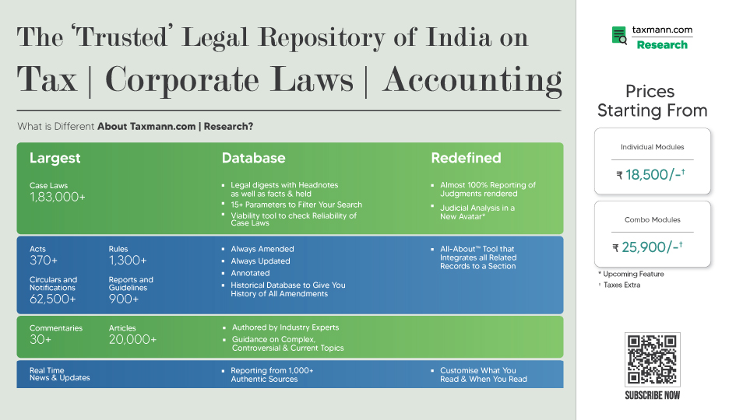

Slide 21










Thank You!
For More Information, Visit: https://taxmann.com/
Follow us on Social Media
Download Taxmann App

